Slide 1
Predictive Modeling for Course Demand and Revenue Forecasting
Name: Madhushree S G
Internship ID: UMID07022680379
Course: Internship Project
Organization: Unified Mentor
Date: March 2026

Slide 2
Abstract
Machine learning system to predict course demand and revenue.
Uses course features like price, duration, ratings.
Interactive Streamlit dashboard for insights.

Slide 3
Introduction
Online learning is growing rapidly.
Predicting course demand is challenging.
ML helps analyze patterns and predict enrollments.

Slide 4
Problem Statement
Difficulty in predicting enrollments before launch.
Leads to poor pricing and low revenue.
Need intelligent predictive system.

Slide 5
Objectives
Predict enrollments
Estimate revenue
Build interactive dashboard
Provide visual insights
Support decision making

Slide 6
Existing System
Manual estimation
No predictive analytics
Limited insights
Inefficient planning

Slide 7
Proposed System
ML-based prediction system
Real-time predictions
Interactive dashboard
Data visualization

Slide 8
Dataset Description
Course data: price, duration, rating
Instructor data: experience, rating
Transaction data: enrollments, revenue

Slide 9
Methodology
Data collection
Preprocessing
EDA
Feature Engineering
Model building
Evaluation

Slide 10
EDA Insights
High ratings → high enrollments
High price → lower demand
Technical courses more popular

Slide 11
Models Used
Linear Regression (baseline)
Random Forest (advanced)
Better accuracy with Random Forest

Slide 12
Model Evaluation
Metrics: MAE, RMSE, R²
Random Forest performed better
Handles complex relationships

Slide 13
Results & Insights
Ratings strongly impact demand
Optimal pricing is important
Instructor quality matters

Slide 14
Business Impact
Better pricing strategy
Improved planning
Efficient resource allocation
Data-driven decisions

Slide 15
Conclusion
ML improves demand prediction
Dashboard supports decision-making
Scalable solution for EduPro

Slide 16
References & Links
GitHub & Streamlit links
Python, Scikit-learn, Plotly, Streamlit

Slide 17
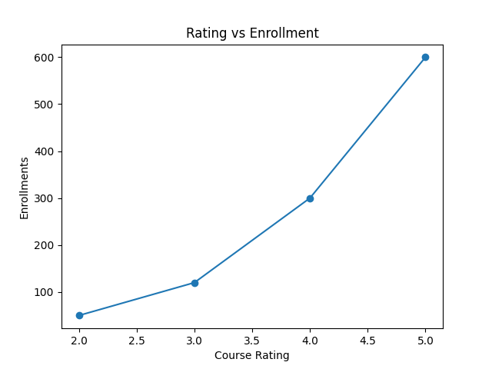
EDA: Rating vs Enrollment

Slide 18
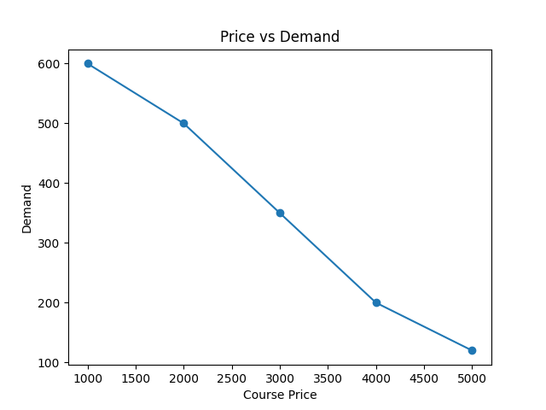
EDA: Price vs Demand

Slide 19
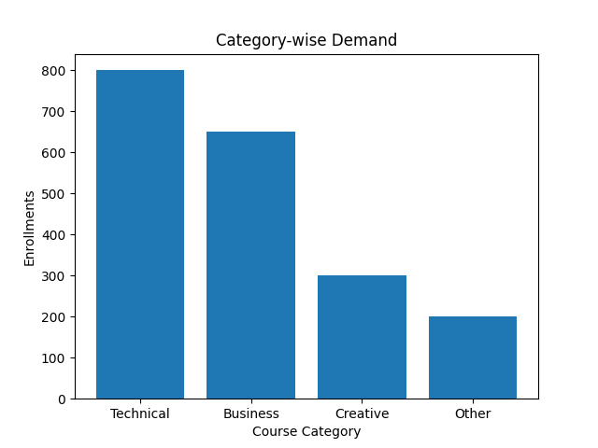
EDA: Category-wise Demand

